Slide 1
SOFTWARE ENGINEERING Section: L Course Instructor: Dr. Razib Hayat Khan

Slide 2
Group Members
Name | ID
Farhabi Mostafa Momo | 18-36766-1
Ahmed Fardit | 18-36119-1
Mahfuzul Alam | 18-36746-1
MD Raitul Islam Sams | 18-36788-1

Slide 3
“BLOOD SOURCE”

Slide 4
Contents
Problem statement
Solution
Introduction
Objectives
Use Case Diagram
User Story Cards
Application Interface
Activity Diagram
Class Diagram
Process Model and Tools
Timeline Charts
Project Scheduling
Budgeting
Conclusion
References

Slide 5
Problem Statement
Unavailability of blood and organ during emergency.
Less awareness among people about blood and organ donation.
Deaths due to lack of blood/organ during operations.
Shortage and sometimes unavailability of rare blood groups.

Slide 6
Solution
A better idea is to use mobile application.
This application is providing user the facility to approach nearby donors so that it will become much easier to search rare blood groups and human organ in the hour of need.

Slide 7
Introduction
‘Blood Source’ is a social help application that helps to manage blood and organ in emergency situation. Anyone can sends request for emergency blood/organ and the donor can check the request with contact information. Anyone can find donor list in their particular region. The main objective of this app is to save people by providing blood or human organ in their emergency situation and make it easier than before.

Slide 8
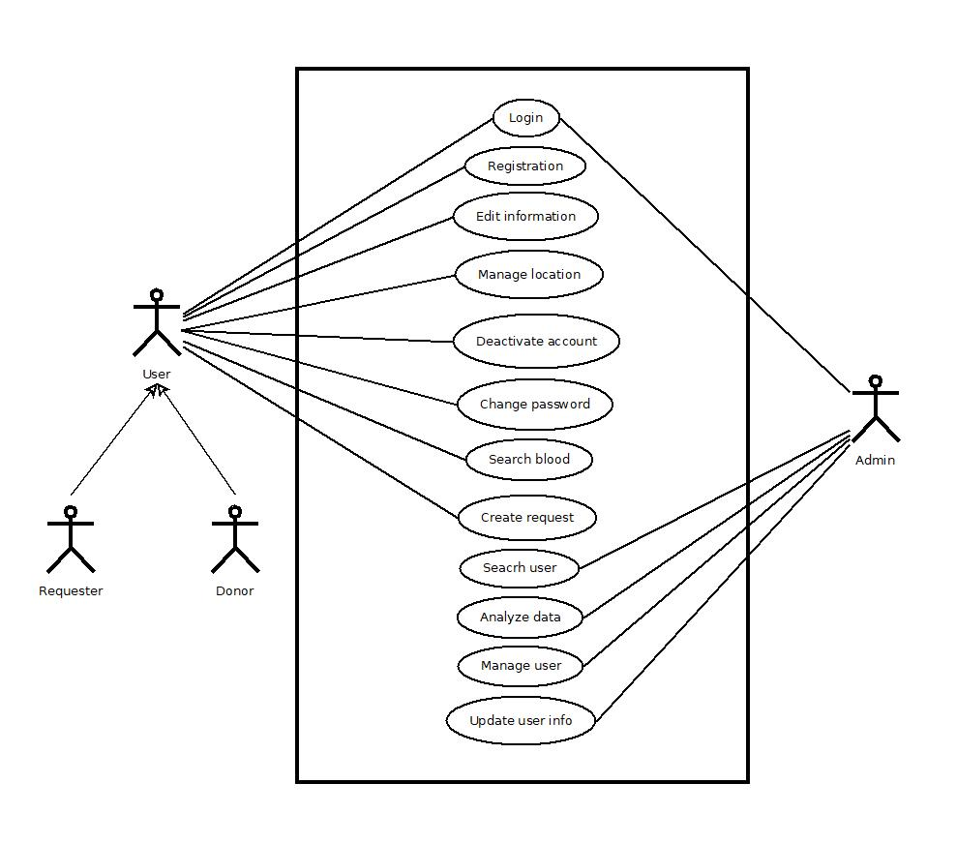
Use Case Diagram
Actors
User
Donor
Requester
Admin
Fig: Use case diagram

Slide 9
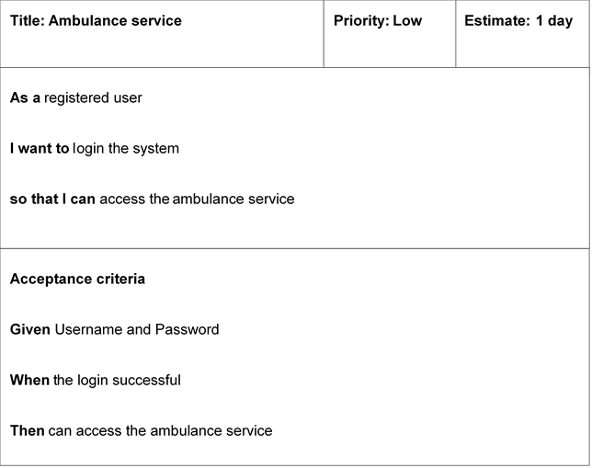
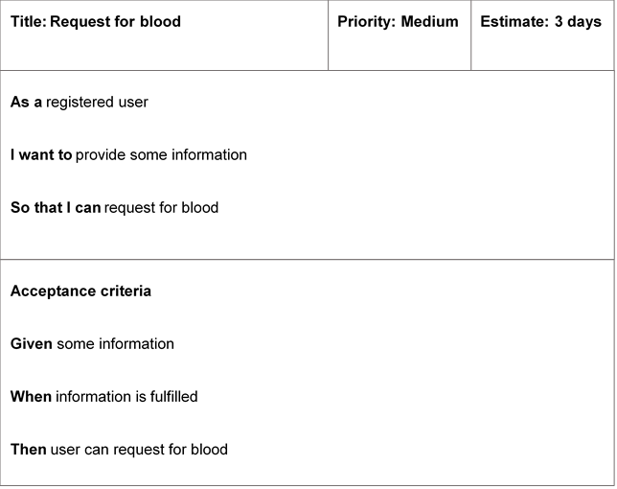
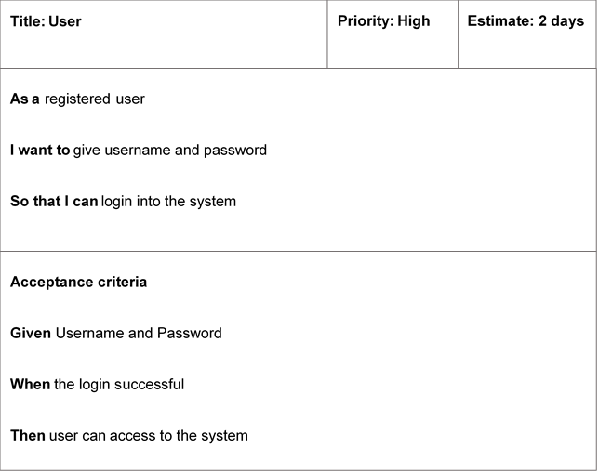
User Story Cards

Slide 10
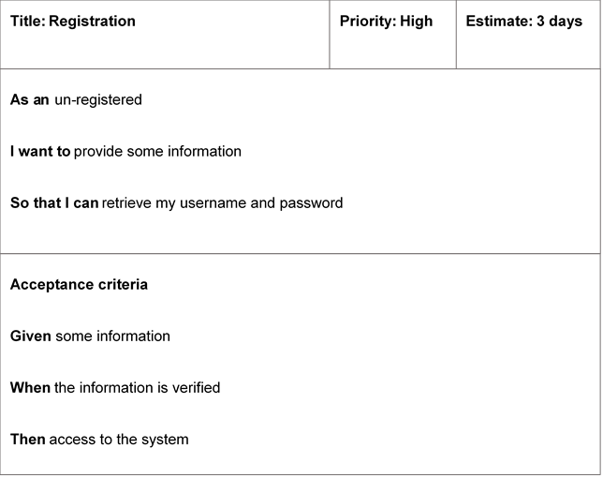
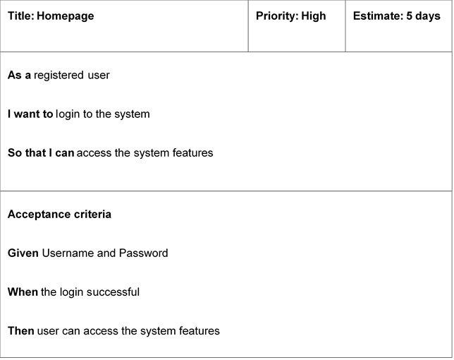
User Story Cards

Slide 11
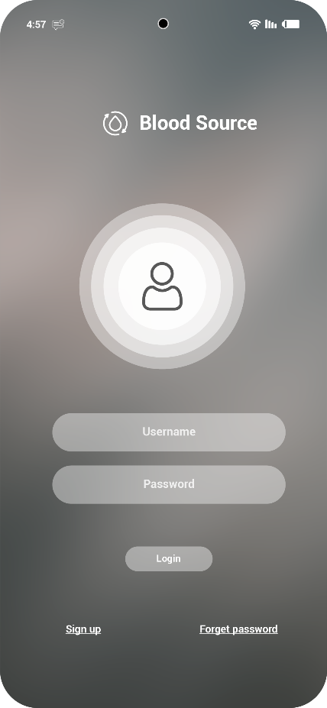
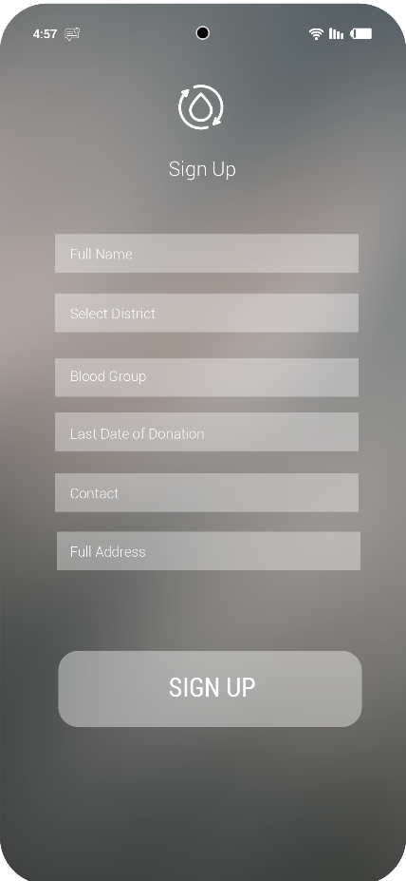
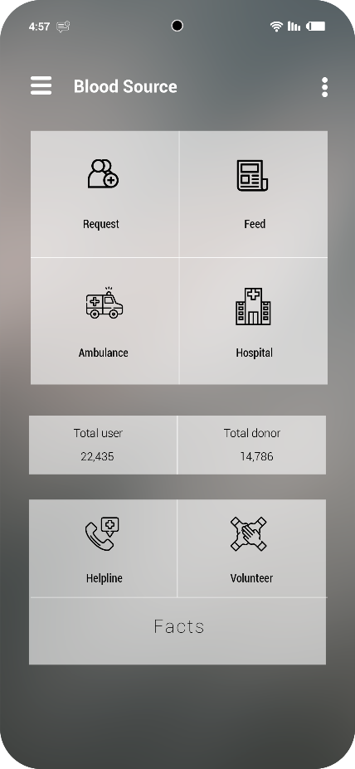
Application Interface
Fig: Login
Fig: Sign up
Fig: Index

Slide 12
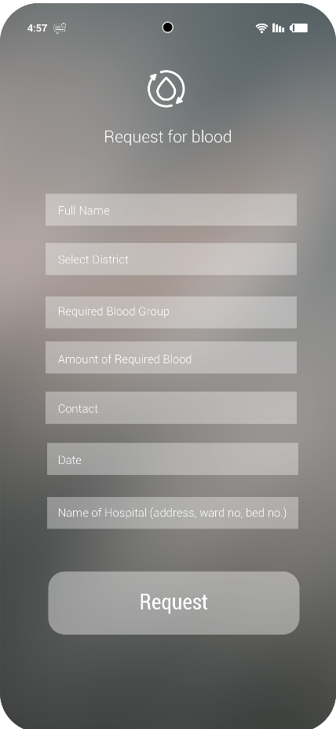
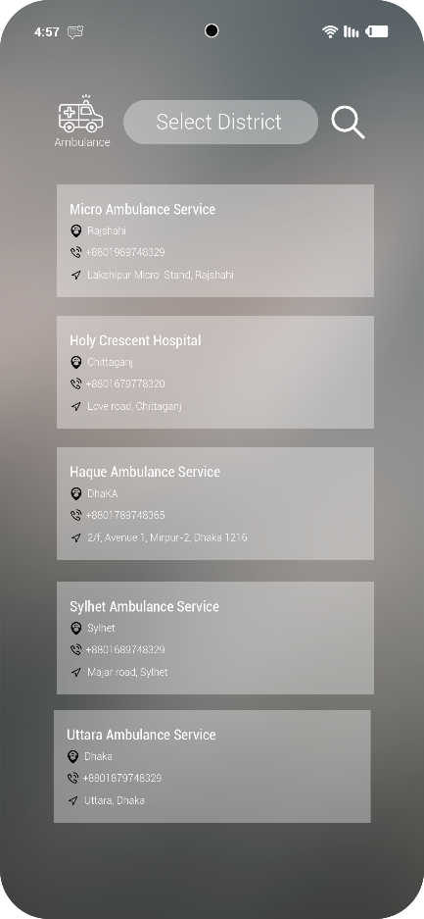
Application Interface
Fig: Request for blood
Fig: Available ambulance

Slide 13
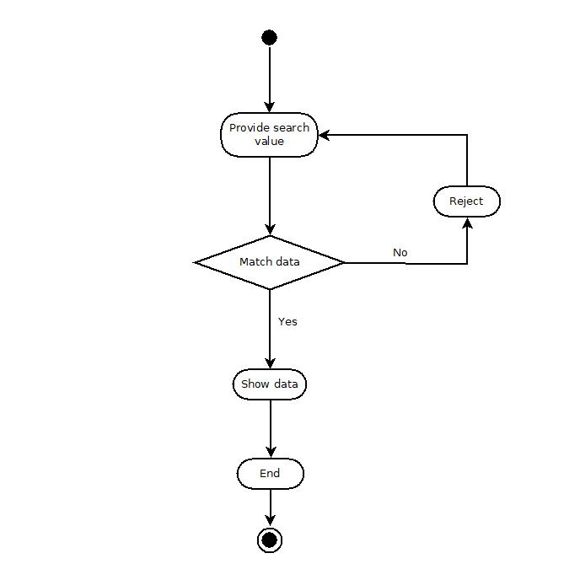
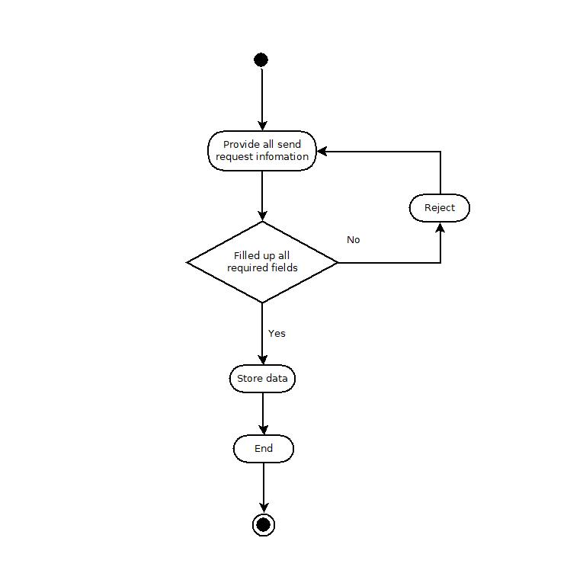
Activity Diagram
Fig: Search blood
Fig: Send request

Slide 14
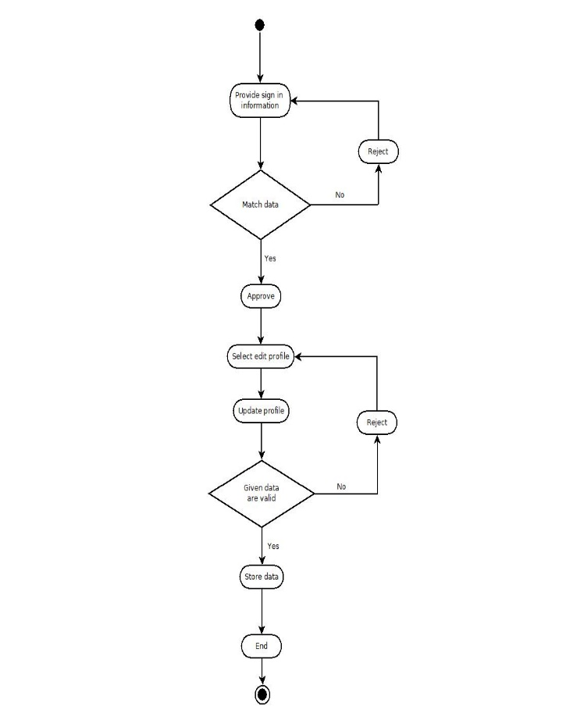
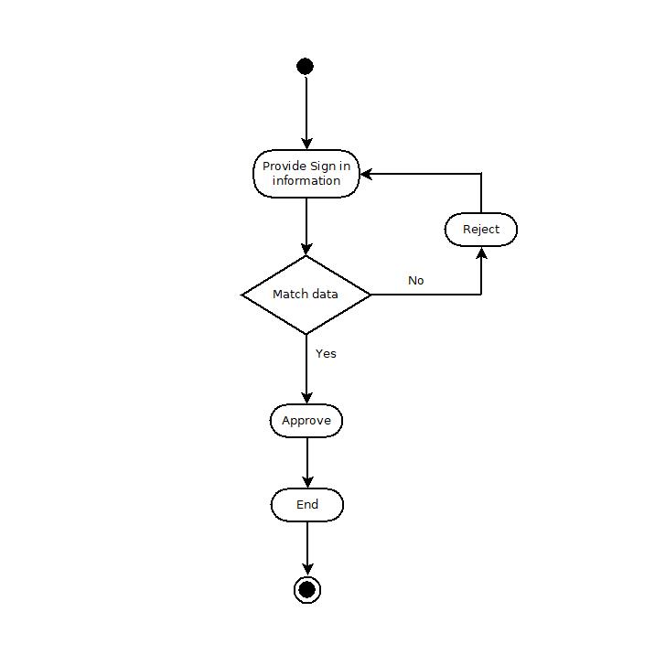
Activity Diagram
Fig: Edit profile
Fig: Sign in

Slide 15
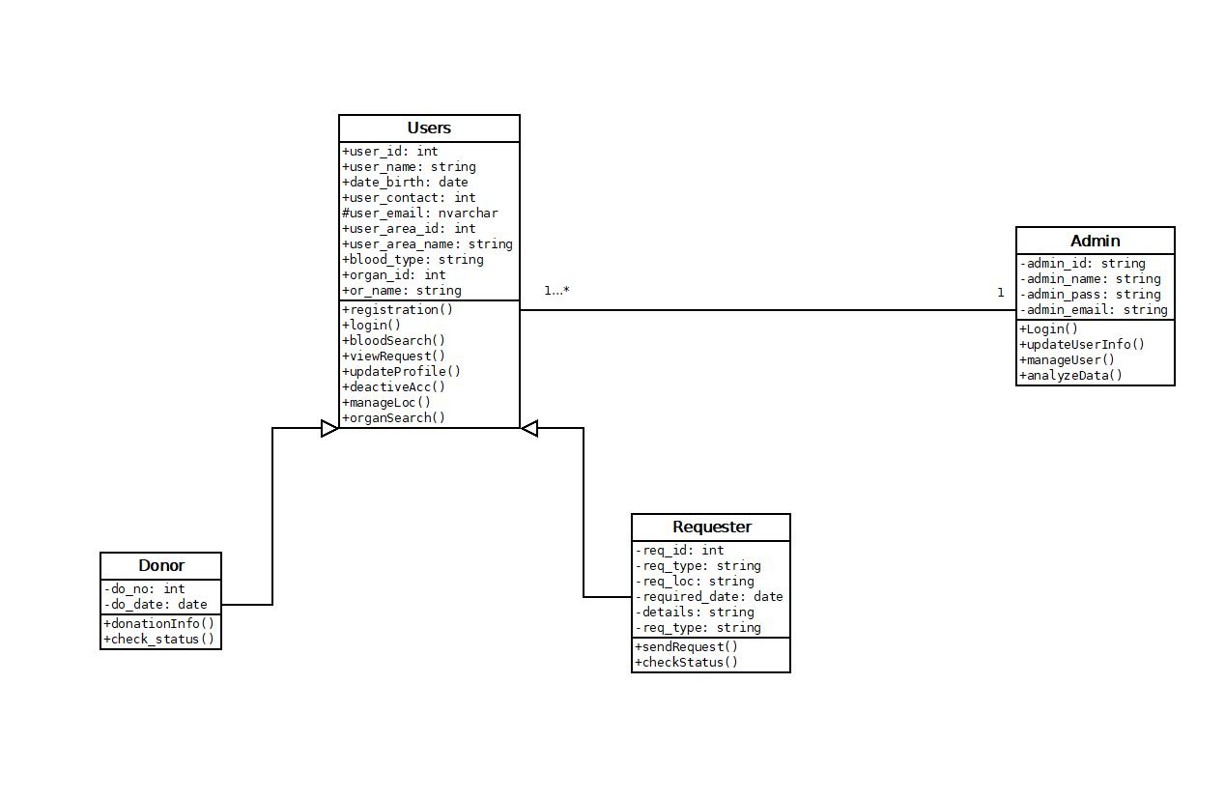
Class Diagram
Fig: Class diagram

Slide 16
Process Model and Tools
SCRUM
GitHub
Jira software
Dia Editor

Slide 17
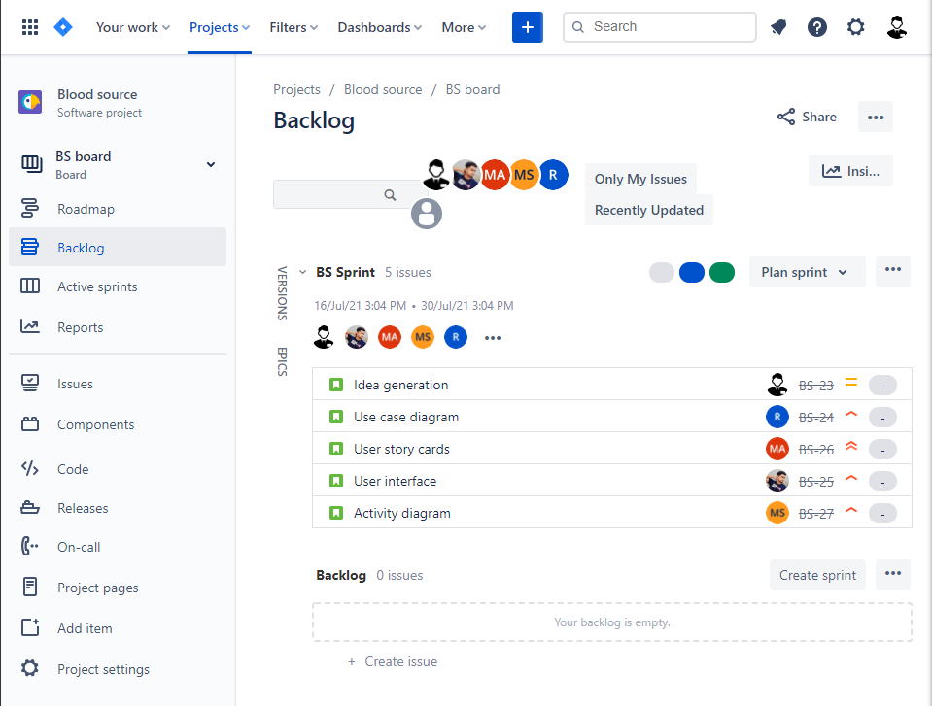
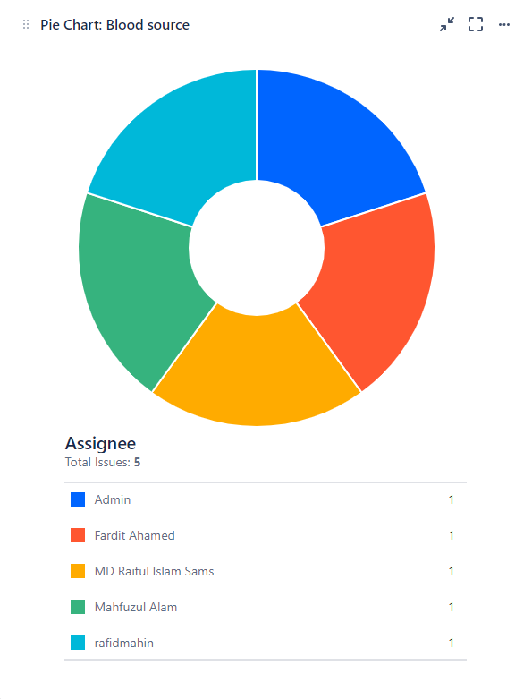
Jira Software
Mostafa SFarhabi
Fig: Issue create
Fig: Issue assign

Slide 18
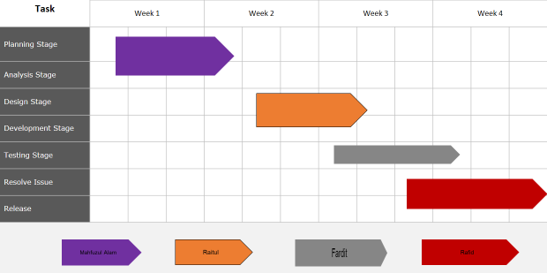
Timeline Chart

Slide 19
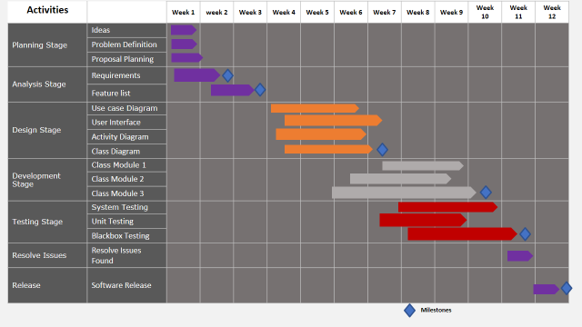
Timeline Chart

Slide 20
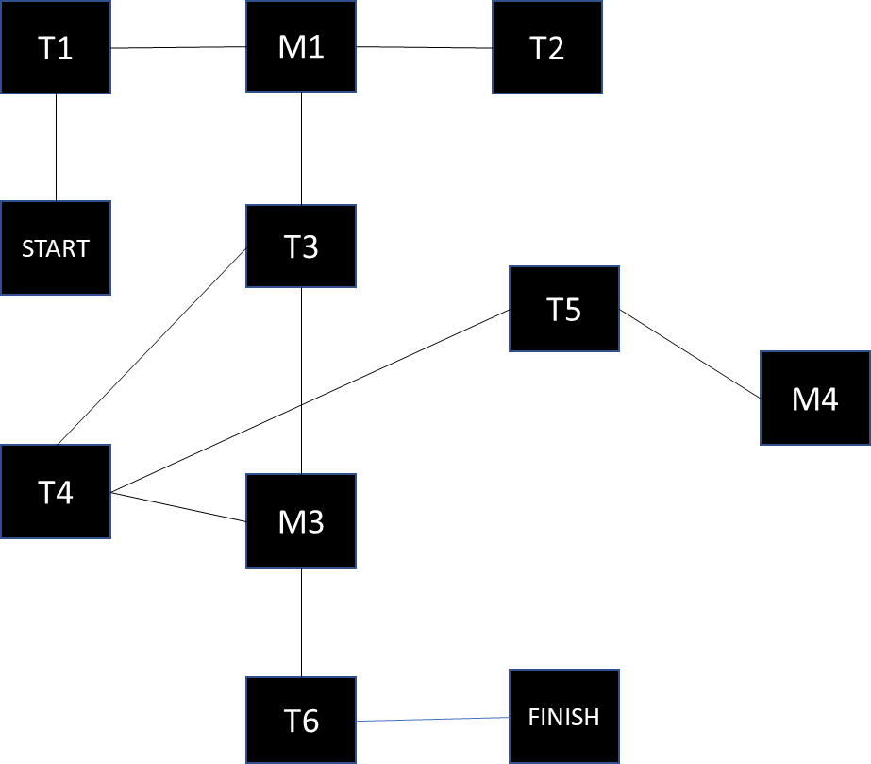
Project Scheduling
Month | 1 | 2 | 3 | 4 | 5 | 6 | 7
T1
T2
 |  | T3
T4
 |  |  |  | T5
 |  | T6

Slide 21
Budgeting
Constructive Cost Model:
Project Type: Organic
Coefficient<Effort Factor>: 2.4 [P = 1.05; T = 0.38]
SLOC = 10000 Lines
Person Months, PM = (2.4 * 101.05) = 26.938
Dev. Time, DM = (2.5 * 26.9380.38) = 8.74 = 8 months = 1408 Working Hour
Required Period, ST = PM/DM = 3.02 = 4 people
Developer Salary in 8 months: Per developer salary per working hour = 600 Taka
Total developer salary = 600 * 1408 = 844,800 Tk
Requirement analysis:
Time needed 1 month (22 working days = 176 working hour)
Req analysis person’s hourly wage = 400 Tk
Total req analysis expense = 400 * 176 = 70,400 Tk
Transportation cost estimation: 10,500 Tk
Training & hardware expense estimation: 12, 0000 Tk
Rent expense:
Room per month = 8000 Tk
Total in 8 month = 64,000 Tk
Total utilities in 8 months: 19,500 Tk
Maintenance (Till 6 months after delivery):
Expense per hour = 1000 Taka
Total estimated time needed for maintenance = 60 hours
Total estimated maintenance expense = 60 * 1000 = 60,000 Taka
Total estimated expense:
844800 + 70400 + 10500 + 120000 + 64000 + 19500 + 60000
= 1189,200 Taka
Profit:
20% of total estimated expense = 1189200 * 20% = 237840 Taka
Project Budget: 1189200 + 237840 = 14,27040 Taka

Slide 22
Conclusion
Helping people in their emergency situation by providing them blood and human organ is the main aim of this application. This application can reduce the time to a greater extent that is searching for the blood/organ. It also provides the required information in less time and also helps in quicker decision making.

Slide 23
Reference
AIUB software engineering slides
https://bloodsource.atlassian.net/secure/RapidBoard.jspa?rapidView=1&projectKey=BS&view=planning.nodetail&issueLimit=100
https://en.wikipedia.org/wiki/Agile_software_development
https://my.clevelandclinic.org/health/articles/11750-organ-donation-and-transplantation

Slide 24
THANK YOU

